Slide 1
FRB Update #19
William Huang
10/5/2020

Slide 2

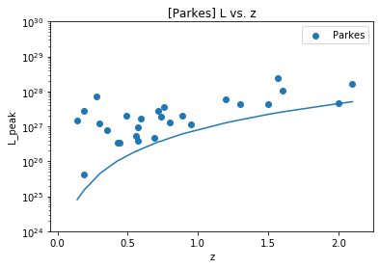
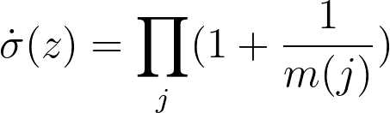
Determining
NEW STEP: transform L to “local values” using k=0, 2, or 4. Then:
Where j is all the FRBs < z
m(j) is the number of FRBs in the associated set with L > L_lim and z < z_j

Slide 3
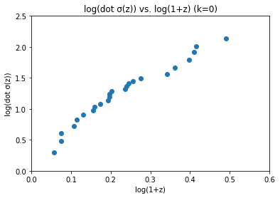
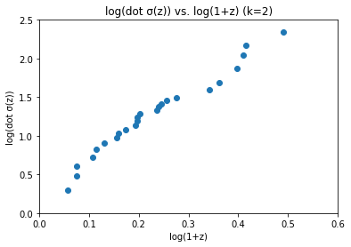
Graphs of

Slide 4
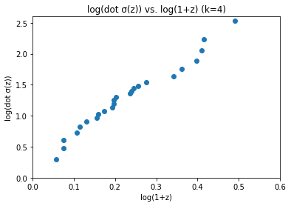
(cont.)

Slide 5

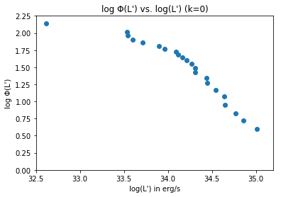
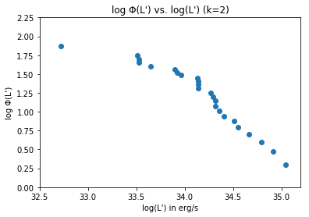
Graphs for k=0, 2, and 4:

Slide 6
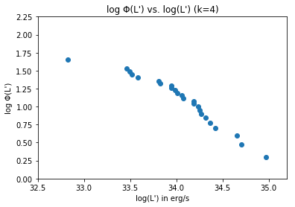
(cont.)

